Slide 1




THE POWER OF RECRUITMENT
IN BUILDING A WINNING TEAM

Slide 2

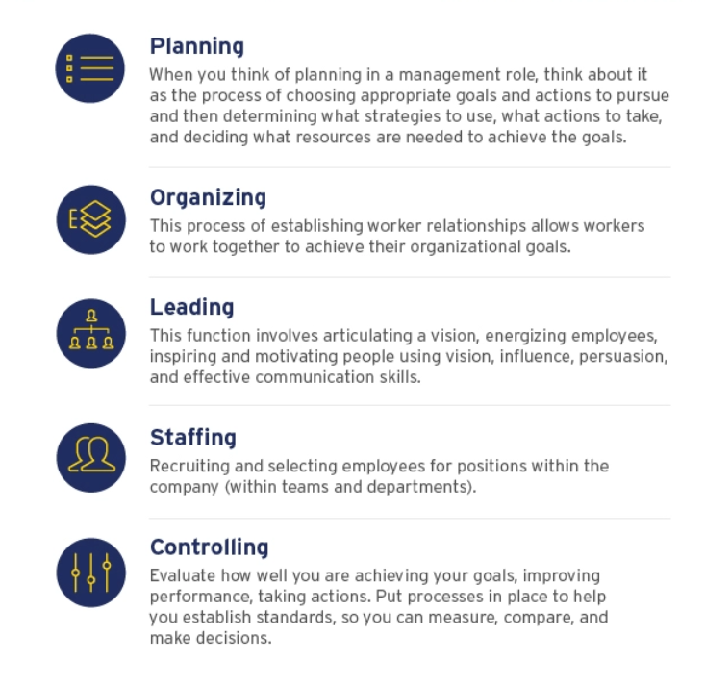
5 Functions of
Great Management

Slide 3




IMPORTANCE OF
RECRUITMENT

Slide 4



Ensures that the daily activities of your organization are carried out seamlessly

Slide 5


Increases Organizational Effectiveness

Slide 6

Cost-Effective

Slide 7

Improves the Credibility of the Organization

Slide 8
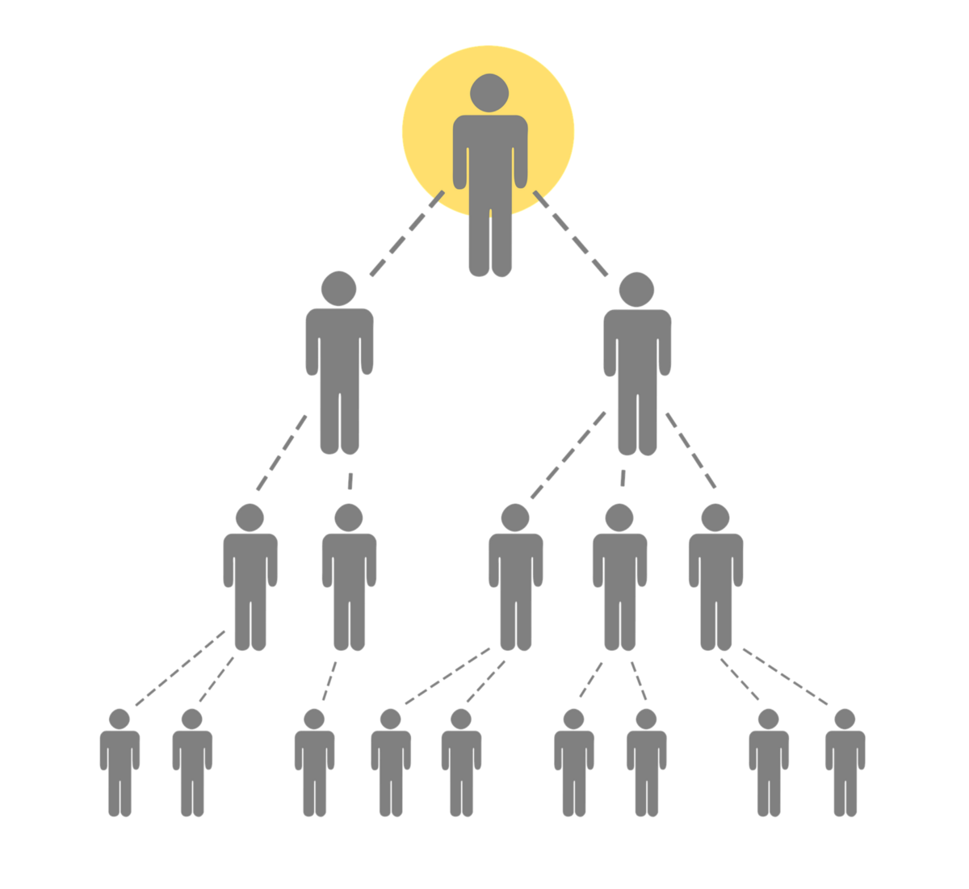

Overrides from Recruits

Slide 9






SALES ORGANIZATION STRUCTURE
Marketing Director
Marketing Manager
Marketing
Associate
Senior Marketing Associate

Slide 10
What makes a good recruiter?

Slide 11
How to be a good recruiter?

Slide 12

How to be a good recruiter?
Establish good relationships

Slide 13

How to be a good recruiter?
Plan ahead

Slide 14

How to be a good recruiter?
Have an open mind

Slide 15

How to be a good recruiter?
Empathize with candidates

Slide 16

How to be a good recruiter?
Look for ways to improve

Slide 17

How to be a good recruiter?
Represent your company well

Slide 18
Energy Giver
Disciplined & Driven
Familiar with the Process
Leader by Example
Shows excellence
SELF

Slide 19



TYPES OF PEOPLE
TO RECRUIT

Slide 20

Types of People to Recruit
Look for people with big dreams.

Slide 21

Types of People to Recruit
People with time

Slide 22

Types of People to Recruit
Recruit clients and COI

Slide 23

Types of People to Recruit
Willingness to Learn and Earn

Slide 24

Types of People to Recruit
Self-motivated

Slide 25

Types of People to Recruit
Culture Fit

Slide 26

Character
Competence
Commitment
Connections

Slide 27

“Hiring people is an art, not a science, and resumes can’t tell you whether someone will fit into a company’s culture.”
– Howard Schultz, Former Starbucks CEO

